Slide 1
Symbiosis
Any close and long-term biological interaction between two different biological organisms. Usually the organisms are of different SPECIES.

Slide 2
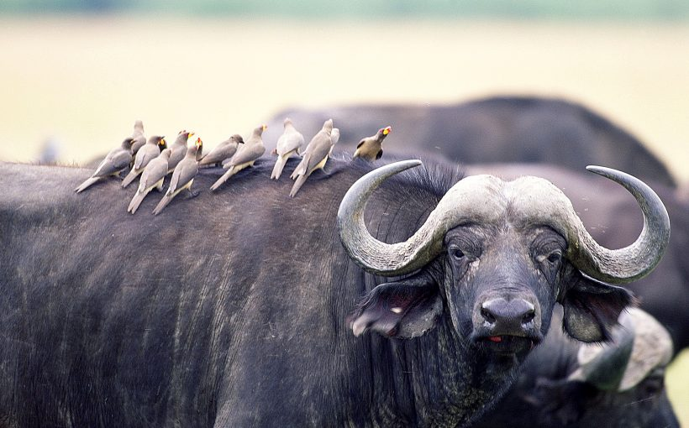
Notes:
Ox and Egret
Birds eat bugs from back of ox.
Bugs bite Ox and can cause infections.

Slide 3
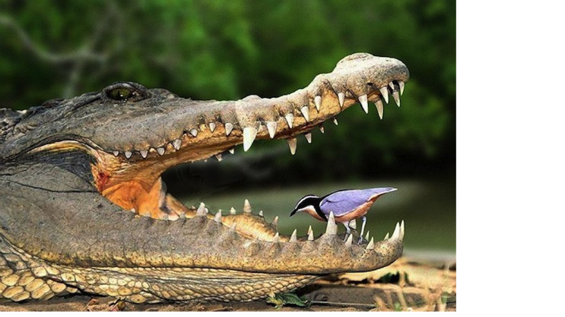
Notes:
Plover cleans teeth, prevents infection.

Slide 4
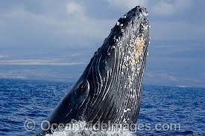
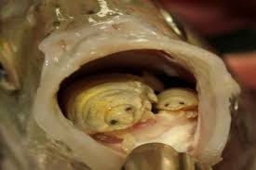
Notes:
Barnacles get transport, food.
Whales usually unharmed.

Slide 5
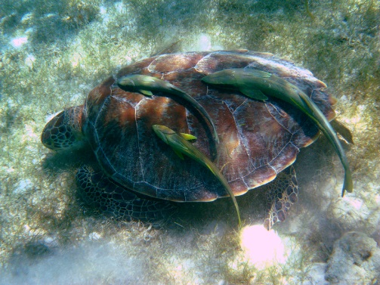
Notes:
Clown fish have a mucus coating that protects from sting.

Slide 6
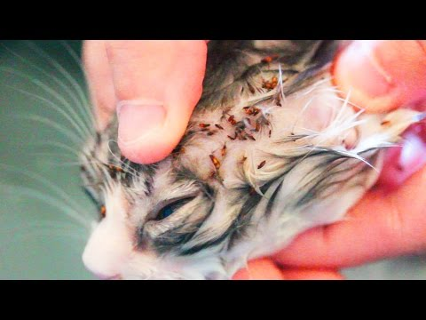
Notes:
Cymothoa exigua
Fish lice move in through gills eventually replace tongue!

Slide 7
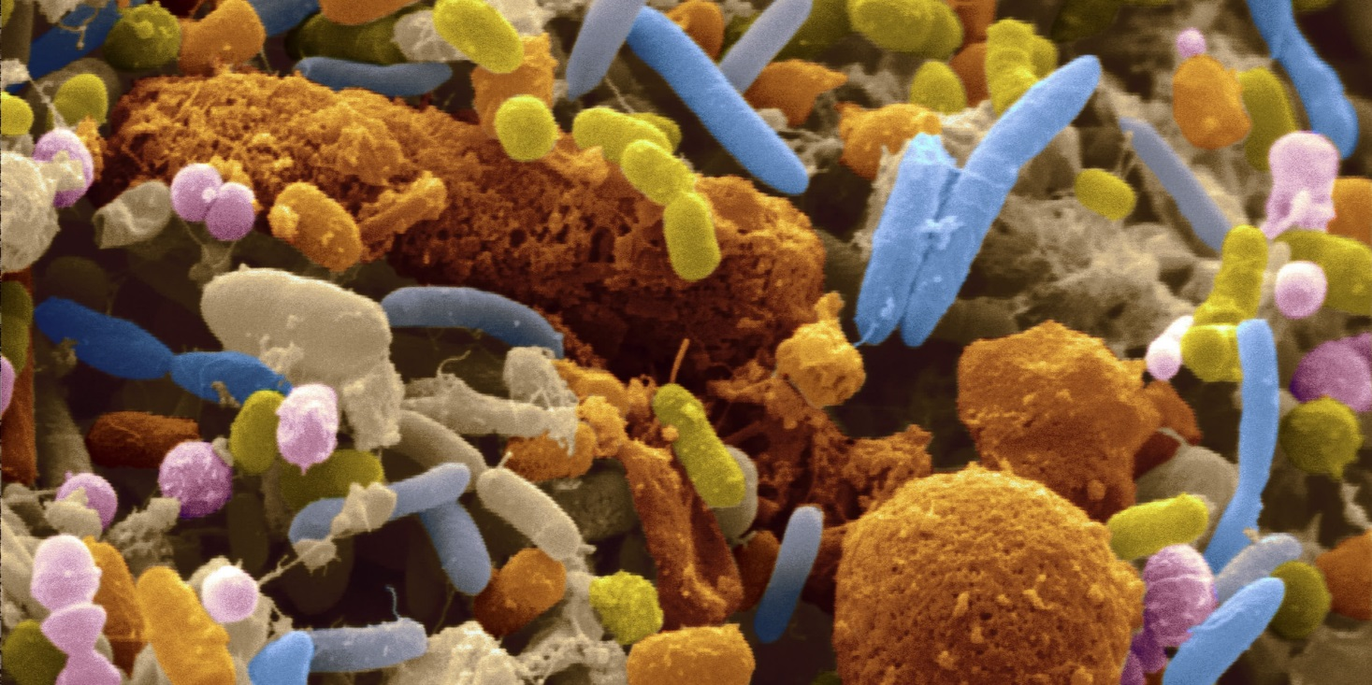
Notes:
100 trillion bacteria in our guts!

Slide 8
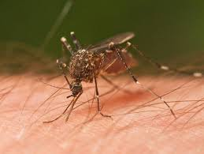

Slide 9
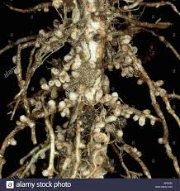
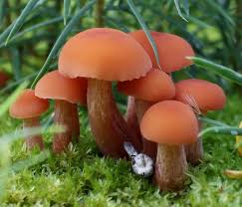
Notes:
Mushroom provide nutrients, plant provides sugars

Slide 10
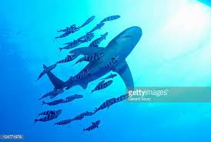

Slide 11
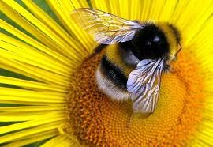
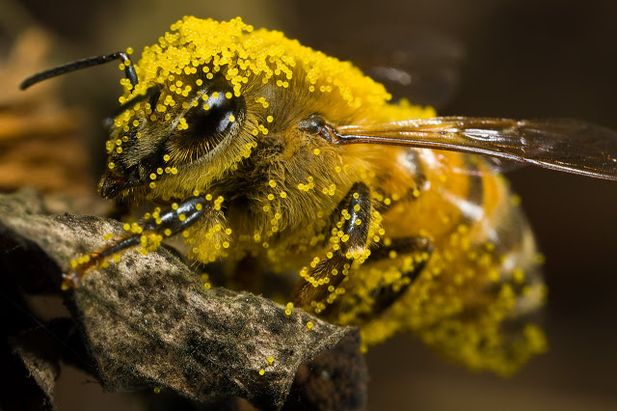
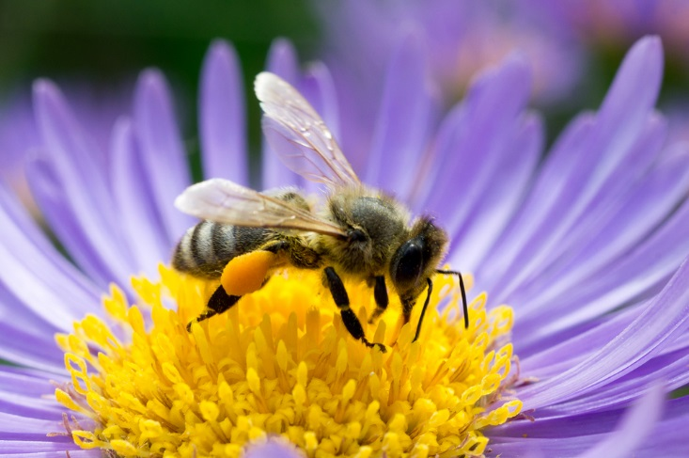

Slide 12
Another example with humans:
The African honeyguide bird leads humans to bee hives. It uses a particular call to guide people to the location of a hive. Once near the hive it changes its call to alert the humans.

