Slide 1
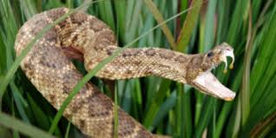
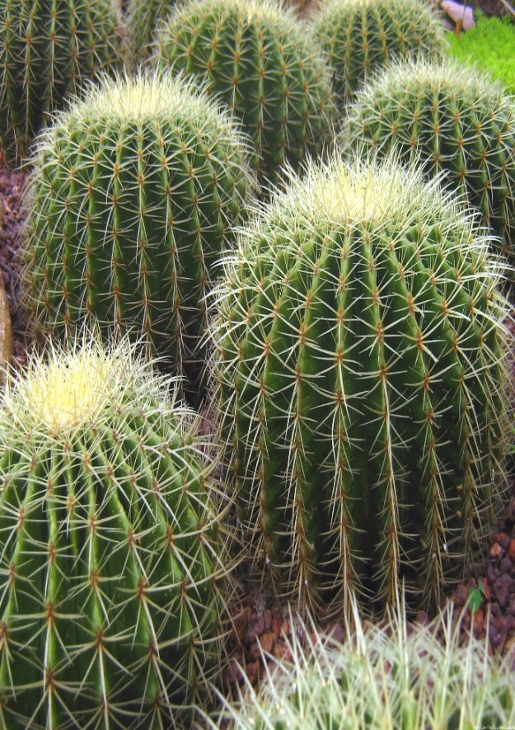
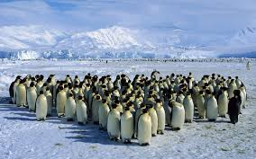
ADAPTATIONS
Organisms (Living Things) like plants and animals have many ways to survive and be successful.

Slide 2
Tigers have large sharp teeth to help them kill and eat prey.

Slide 3
Cacti have needle like leaves to provide shade and prevent water loss.
What other function
do you think the
spines may have?

Slide 4
Some snakes have the ability to produce venom to kill prey and scare off predators.

Slide 5
Penguins huddle close together in large groups to keep warm.

Slide 6
These ways in which organisms are different from each other, the ways in which they have EVOLVED over time to survive, are called ADAPTATIONS
Adaptations can be classified in different ways:
STRUCTURAL ADAPTATIONS:
PHYSIOLOGICAL ADAPTATIONS:
BEHAVIOURAL ADAPTATIONS:

Slide 7
Structural Adaptations:
These are ways in which an organisms physical structure (its body) has evolved to help it to survive.
Structural adaptations would be noticeable if you were to study a dead organism.
Examples include: *Large sharp teeth on predators
*Camouflage
*Large ears of an elephant
*Hollow bones of birds
*Brightly coloured flowers on plants

Slide 8
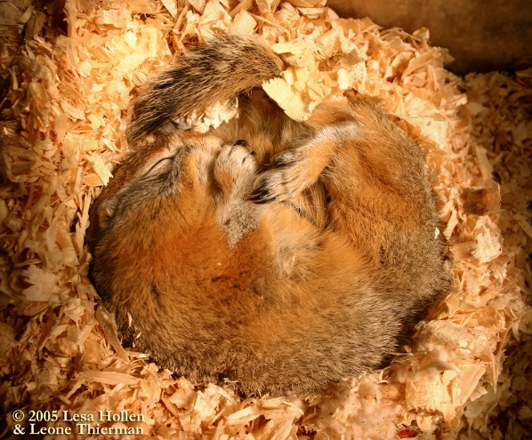
Physiological Adaptations:
These adaptations cannot be seen by looking at an organism. These are ways in which an organism can alter internal processes in order to help survive.
It is more difficult to come up with examples of this type adaptation (although there are many).
*One very common example is HIBERNATION, in which animals can slow down their heart rate and breathing in order to sleep for many months.
*Another example is the production of VENOM or POISON. Some plants and animals can produce chemicals that will harm or kill other organisms.
EXAMPLES: Hibernation
Venom/Poison production

Slide 9
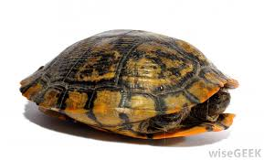
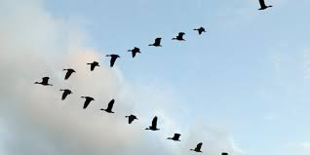
Behavioural Adaptations
These are ways in which animals behave that help them survive. These adaptations can be instinctual or learned.
Examples: *Crows in urban areas have learned to drop nuts onto roadways and
to wait for cars to drive over them to crack them.
(learned)
*Geese fly south to warmer weather in the winter
(instinct)
*Turtles will pull their heads and legs into their shell for protection
(instinct)

Slide 10
On the next few slides there will be pictures and/or descriptions of some adaptations.
Try to decide if the adaptation is
STRUCTURAL
BEHAVIOURAL
PHYSIOLOGICAL
And see if you can describe how that adaptation helps the organism to survive.

Slide 11
The long neck of the giraffe

Slide 12
Humpback Whales blow rings of bubbles to trap fish in the centre.
The whales then swim up from below to eat the trapped fish.

Slide 13
Let’s not forget the plants!
Droseras produce a sticky fluid so when insects land on the plant they become stuck. The plants then digest the unfortunate bug!

Slide 14
How many toads do you see?

Slide 15
Rose bushes are covered in many sharp thorns

Slide 16
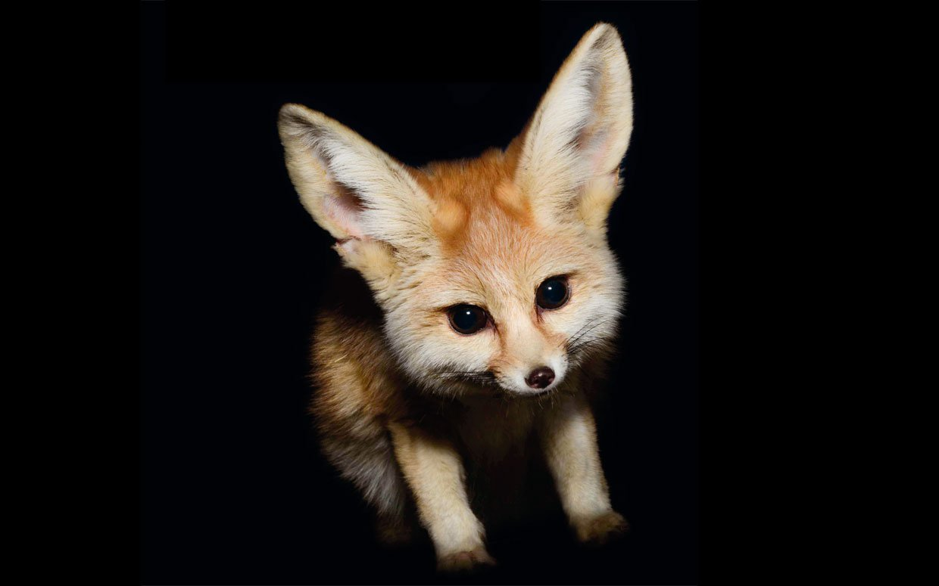
Many animals are NOCTURNAL, meaning they are active at night, and mostly asleep during the day

Slide 17
Give one example of an animal adaptation of your own:
Describe the adaptation and make a sketch.

Slide 18
Give one example of a plant adaptation of your own:
Describe the adaptation and make a sketch.

