Slide 1
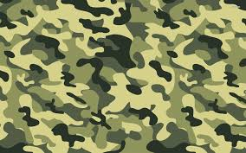
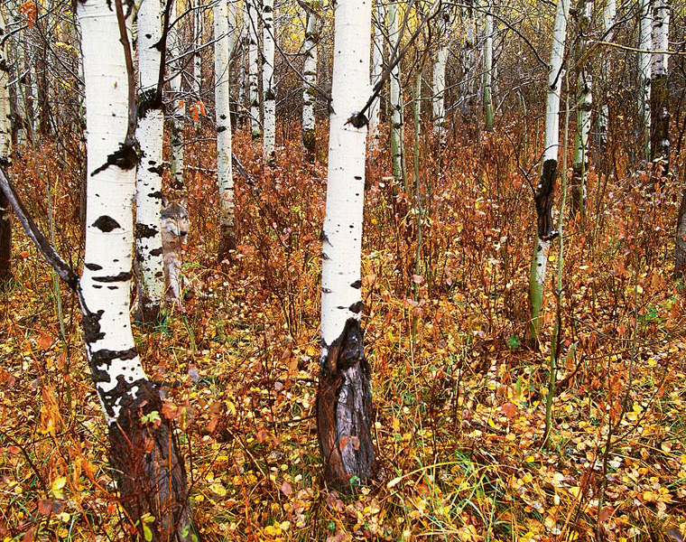
Camouflage
Camouflage is coloring and texturing that helps an organism blend into its surroundings.

Slide 2

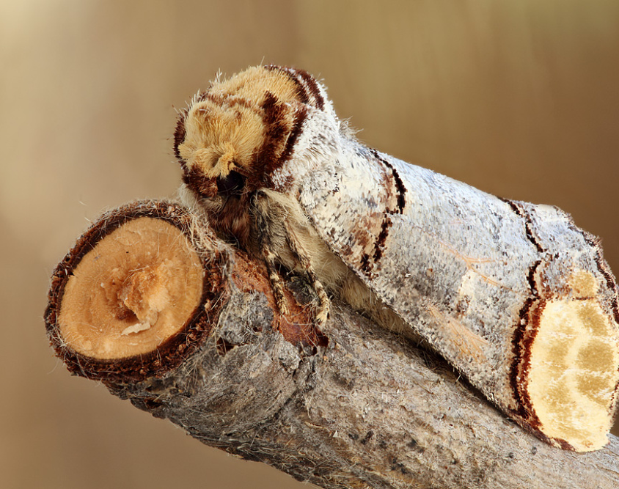
Mimicry
In mimicry one organism has adapted to look* like, or mimic, another organism (or object).
Often this is a form of camouflage.
Sometimes a harmless creature will mimic a dangerous one for protection.
In some cases a dangerous creature mimics a harmless (less dangerous) one.
* Sometimes the organism may mimic sound, or behaviour.

Slide 3
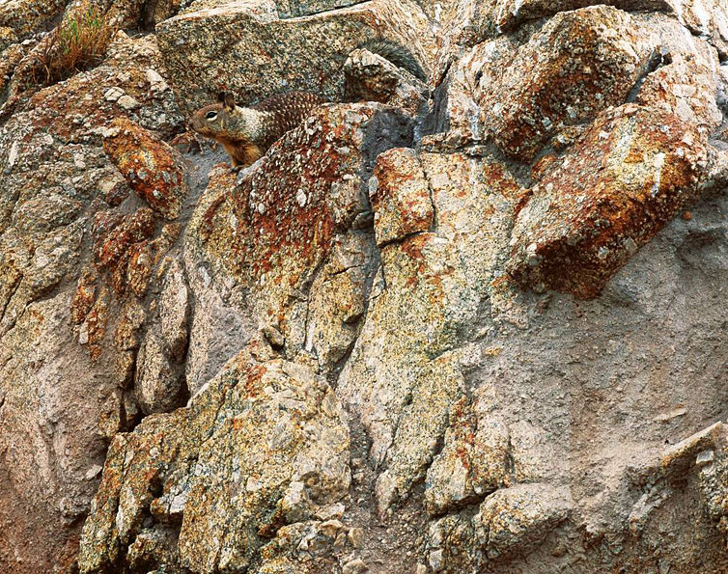
Camouflage or Mimicry?

Slide 4
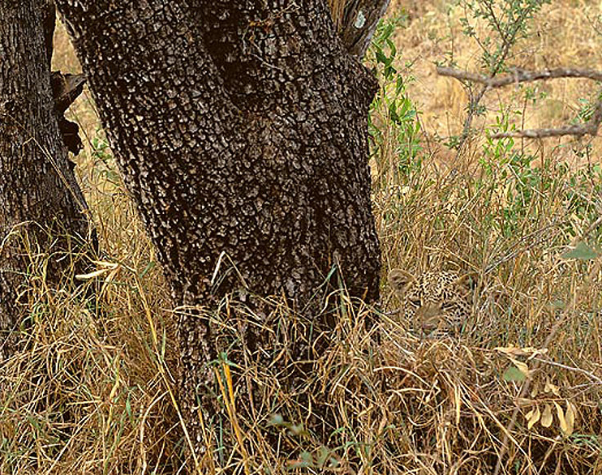
Camouflage or Mimicry?

Slide 5
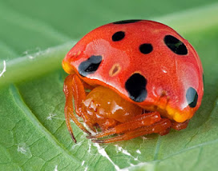
Camouflage or Mimicry?

Slide 6

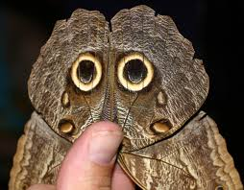
Camouflage or Mimicry?

Slide 7
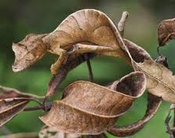
Camouflage or Mimicry?

Slide 8
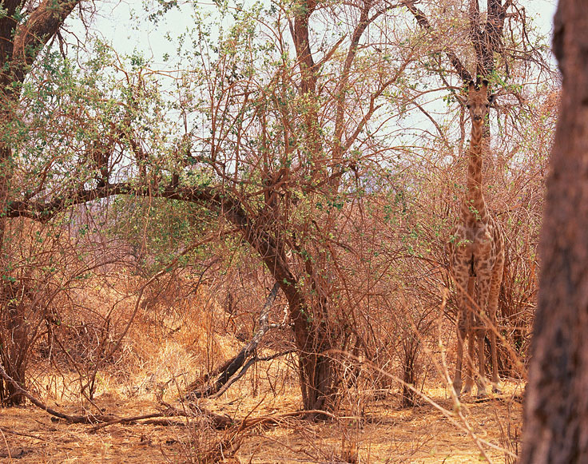
Mimicry or Camouflage?

Slide 9
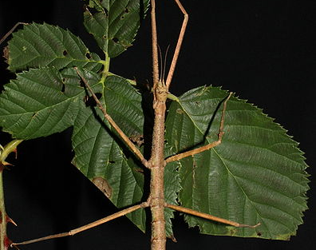
Mimicry or Camouflage?

Slide 10
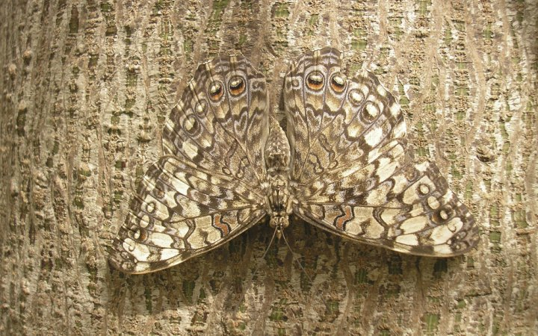
Camo or Mimic?

Slide 11
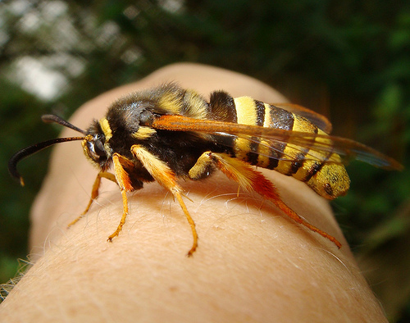
What is this?

Slide 12
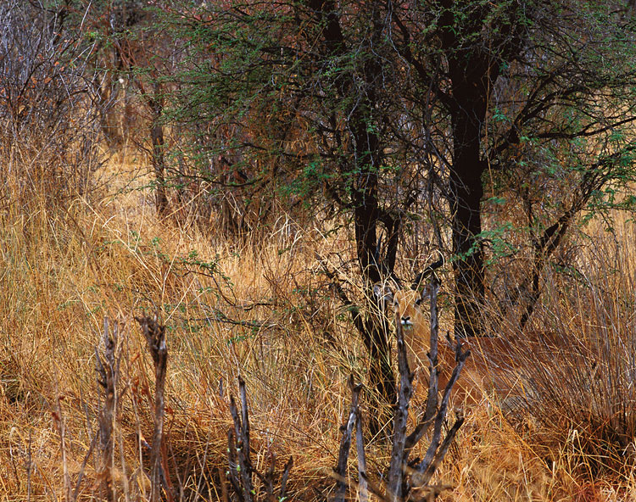
Can you see the animal?

Slide 13
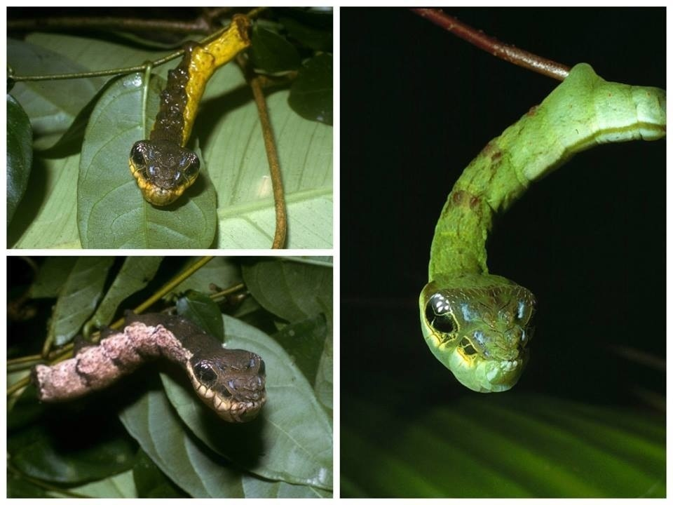
Sure looks like a snake, doesn’t it?
This is the snake caterpillar. It retracts its legs and expands the end of its body which has markings like snake eyes.

Slide 14
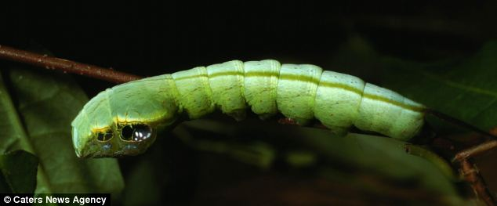
Here is the caterpillar with its end
un-expanded.

Slide 15

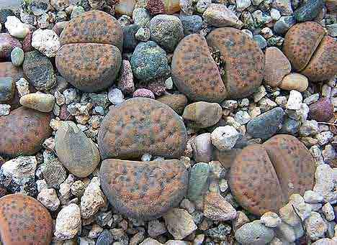
Camouflage or Mimicry?
This is an interesting example, as the organism is mimicking an inanimate (non-living) object!

Slide 16
In mimicry the animal that copies is called the MIMIC
The organism that gets copied is called the MODEL

Slide 17
There are 2 main types of MIMICRY:
Defensive
Aggressive

Slide 18
For Defensive Mimicry there are 3 main types:
Batesian
Mullerian
Emsleyan/Mertensian (rare)

